Slide 1
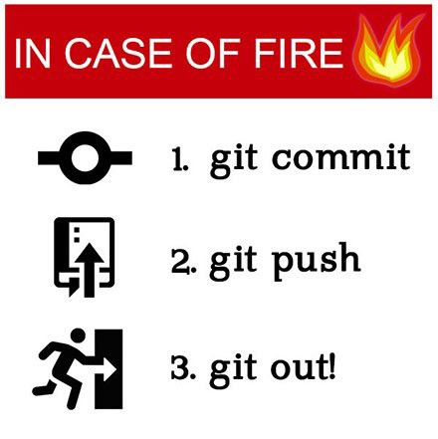
BootUp – Git/GitHub

Slide 2
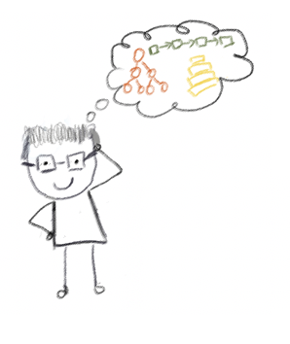


Lecturer
Peng Du
High performance computing
Matrix stuff, Matrix Factorization, etc
Cloud & Edge computing
Kubernetes, docker, etc.
Part-time Teaching
CSS 342
CSS 143
pengdu@uw.edu
Peng Du #6018

Slide 3
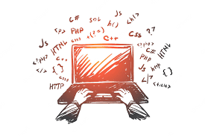
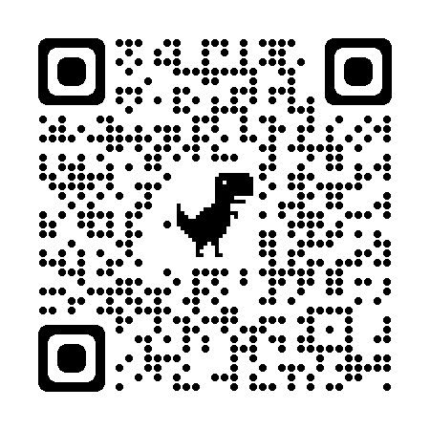
Code & Docs
https://washington.zoom.us/j/96993471995
https://github.com/a-teaching-goose/uwb-bootup/tree/main/docs

Slide 4
Changes

Slide 5
Manage
Changes

Slide 6
What can Git/GitHub do?
How do I do it?

Slide 8

Agenda
ACT I: Baby Steps
Why source control?
Git Basics
Commits
Branches
GitHub Repository
Push, pull, rebase
Local vs Remote
ACT II: Advanced Topics
Collaboration
Pull Request
Merge
Continuous Development
CI & CD

Slide 9
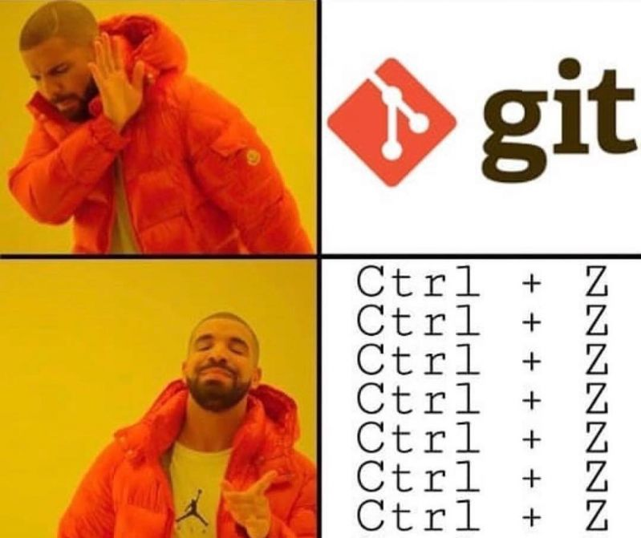

ACT I: Baby Steps
Why source control?
Git Basics
Commits
Branches
GitHub Repository
Push, pull, rebase
Local vs Remote

Slide 10

Who ate your homework?
“My laptop crashed last night, and my homework is gone”

Slide 11
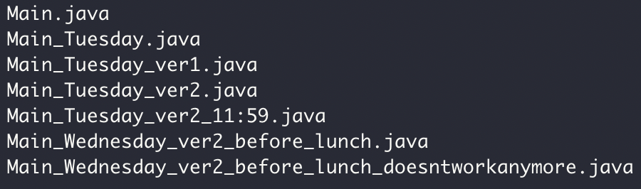

Versions, so many versions

Slide 12
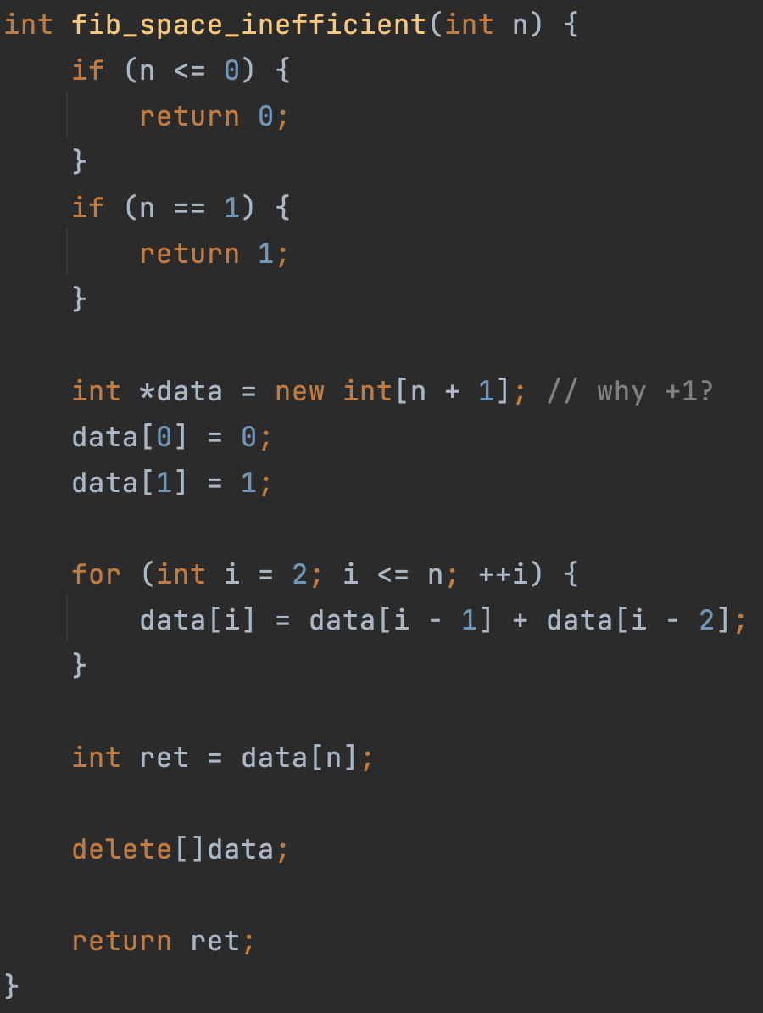
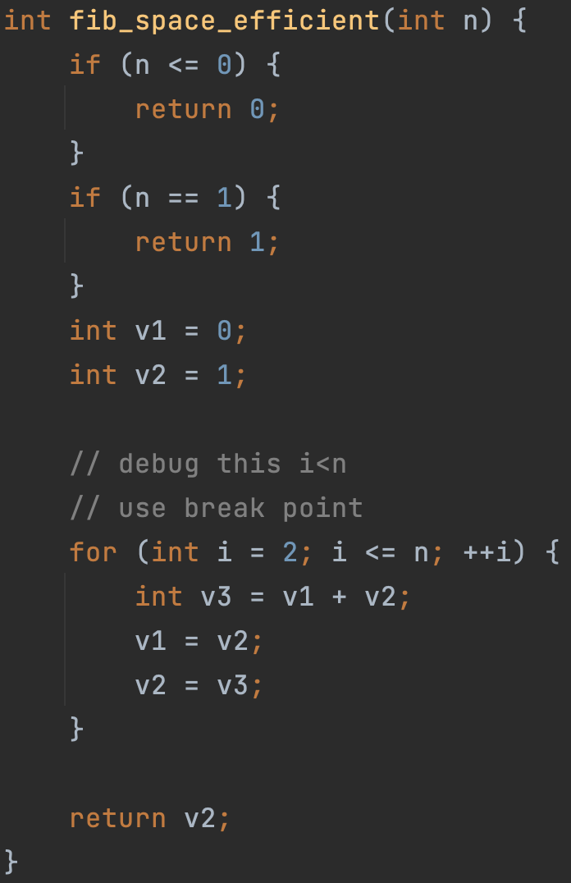

Source Control
Manage Changes
Version 1
Version 2
… …
Monday
Tuesday
Wednesday
Thursday

Slide 13

Why Git and GitHub
Widely used in industry and open-source projects
Easy to track progress (commits)
Easy to track features (branch)
Easy to collaborate with others (GitHub)

Slide 14

Source Control
“commits”
Code version 1
Code version 2
Code version 3
Code
……
Your computer
Monday
Tuesday
Wednesday
Thursday
Time

Slide 15

Code commit 1,2
Code commit 3
Code commit 4,5,6
Code
commit 1
commit 2
Code
commit 3
Code
commit 4
commit 5
commit 6
Code
……
Your computer
Time

Slide 16
Source Control:
Commit 1
Commit 2
Commit 3
Commit 6
Commit 7
Time

Slide 17



Git/GitHub Terms
Repository, or “Repo”
Collection files from a project
Commit
A snapshot of the repo at the certain time
Branch
A line of development, consisting of a series of commits

Slide 18
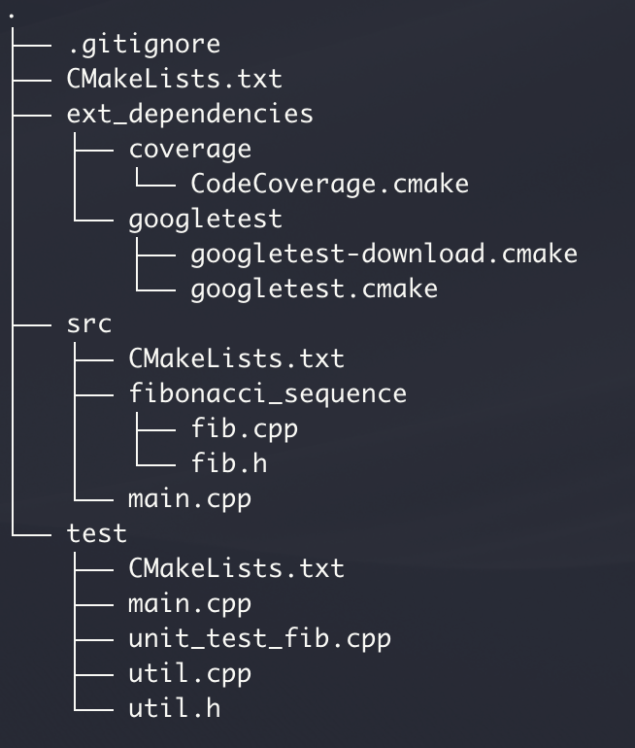
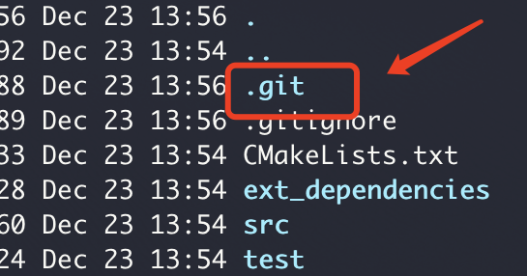

Find the start code here
1
Project folder
Git Repo
git init
“Hey Git! Manage this folder as a repo(sitory)!”
git add .
“Hey Git! Add all the files here to this repo”
git commit -am "my first commit"
“Hey Git! Make a commit (snapshot) of the repo”
“And use a commit message ’my first commit’”

Slide 19

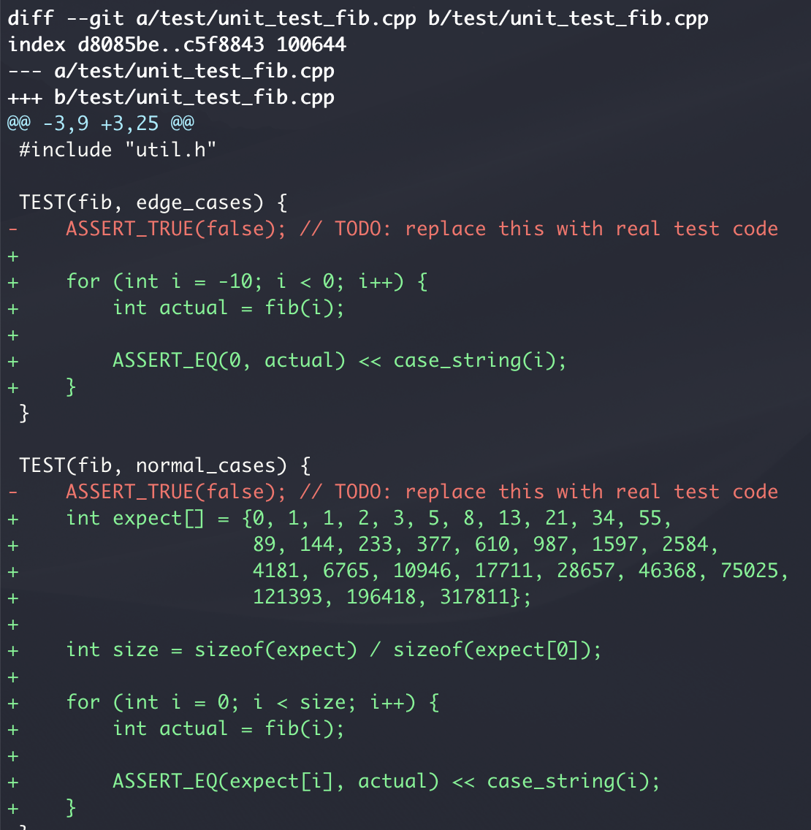
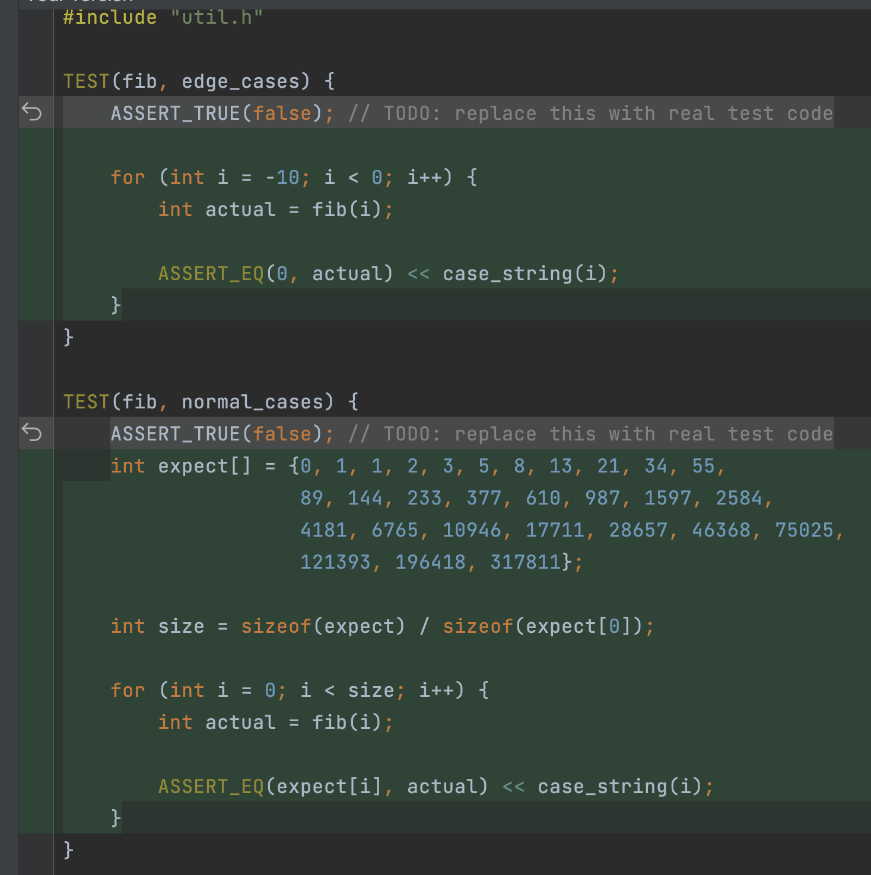
Add unit tests
2
git diff
“Hey Git! Show me what’s changed but not committed since the last commit”
result in command line
result in IDE (CLion)

Slide 20
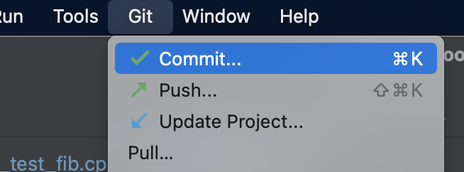
3
git commit -am “add unit tests"
from in command line
from IDE (CLion)
“Hey Git! Commit with message ’add unit tests’”

Slide 21
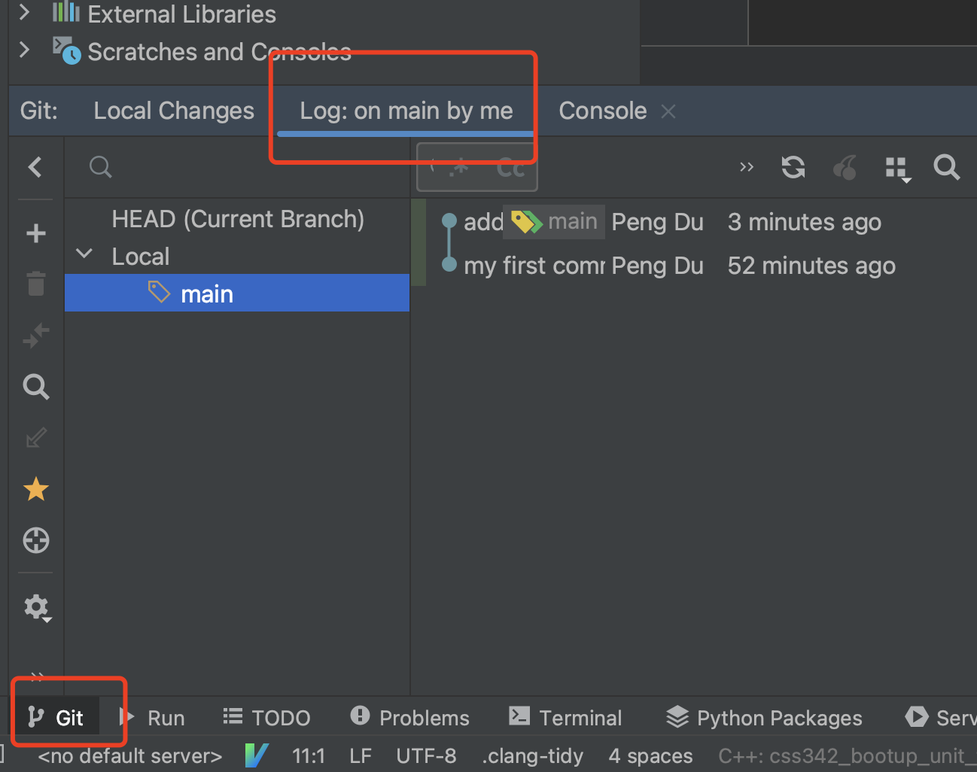
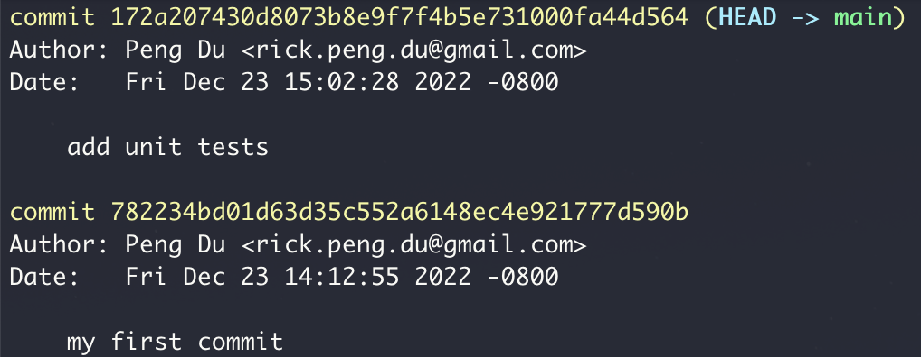
4
git log
from in command line
from IDE (CLion)
“Hey Git! Shows me the list of commits so far’”

Slide 22
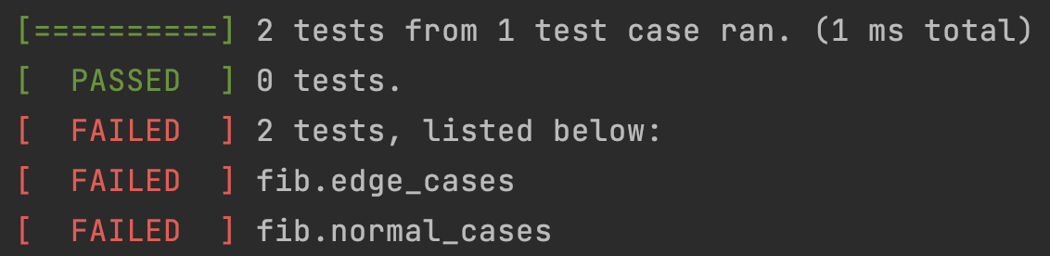
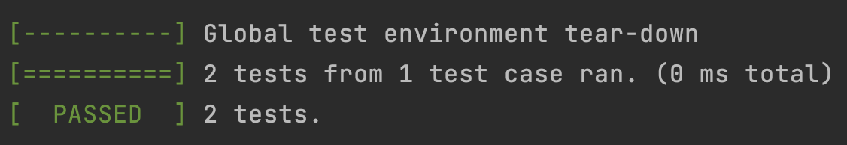
5
Write fib(int n)
git commit -am ”finish fib"
“Hey Git! Make a commit”

Slide 23
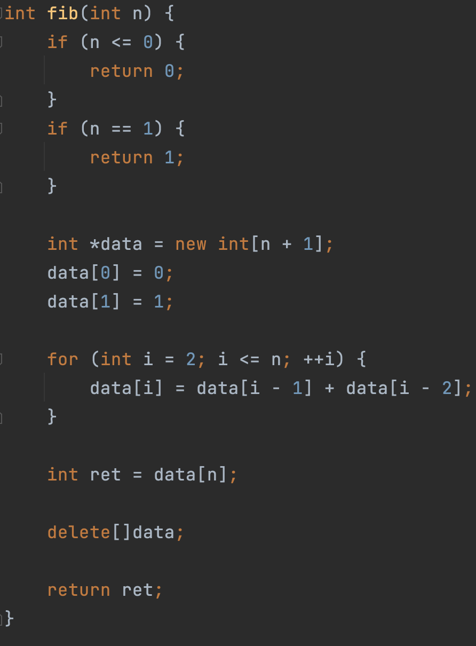

0
1
1
2
3
5
New Idea: What if we don’t use the array?

Slide 24

New idea? Test it in a new branch
Commit 1
Commit 2
Commit 3
Merge, Commit 6
Main branch
New idea branch
Commit 4
Commit 5

Slide 25
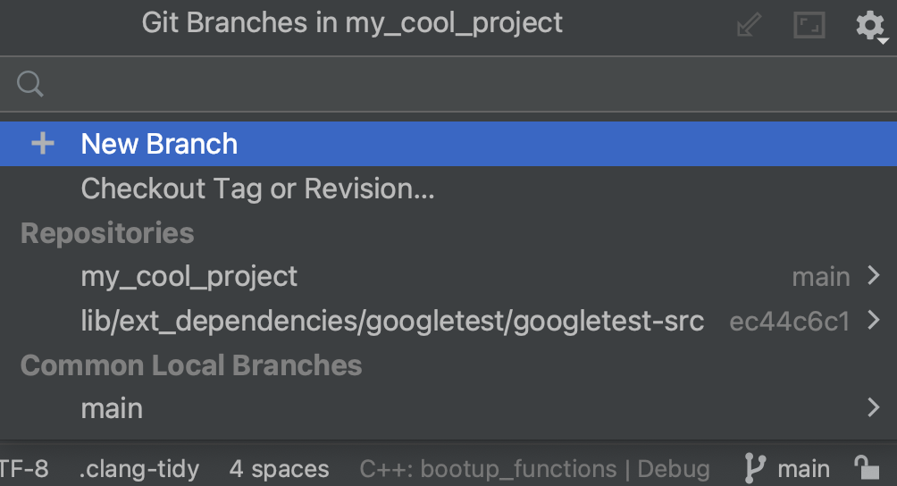
6
git checkout -b new_idea
From command line
from IDE (CLion)
“Hey Git! Create and switch to a new branch called “new_idea”

Slide 26
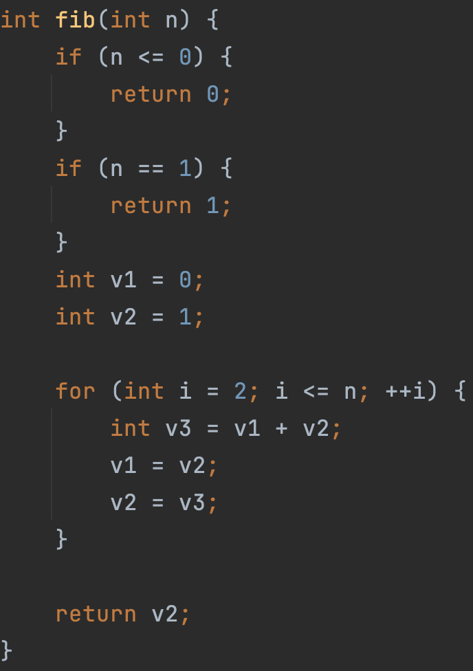
7
Write fib(int n) with new idea

Slide 27
8
git commit -am "finish fib with new idea"

Slide 28
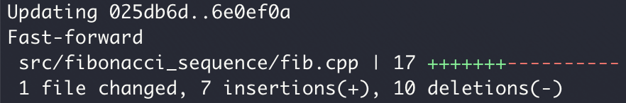
9
Merge new idea into the main branch
git checkout main
“Hey Git! Switch back to the main branch”
git merge new_idea
“Hey Git! Merge the code in new_idea branch to the current branch (main)”

Slide 29
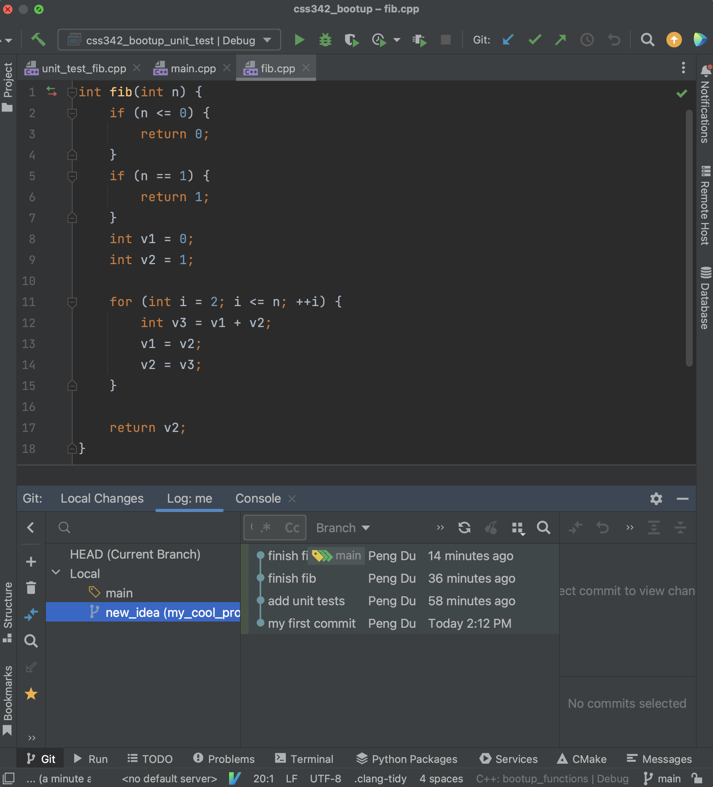
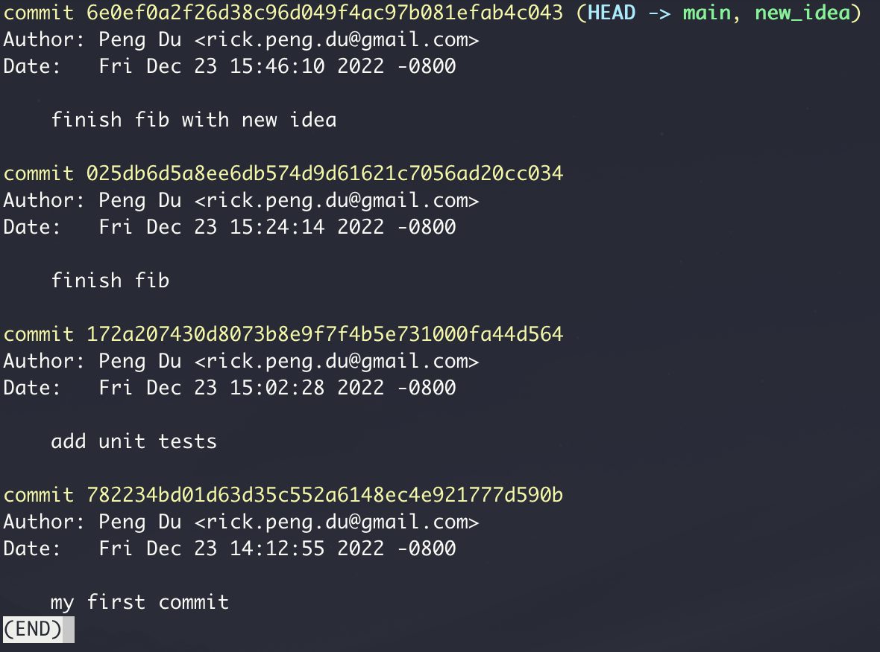
git log
from in command line
from IDE (CLion)

Slide 30
git init
git add .
git commit -am "commit message"
git diff
git log
git checkout -b new_idea
git merge new_idea

Slide 31

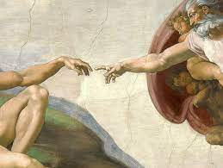


Slide 32

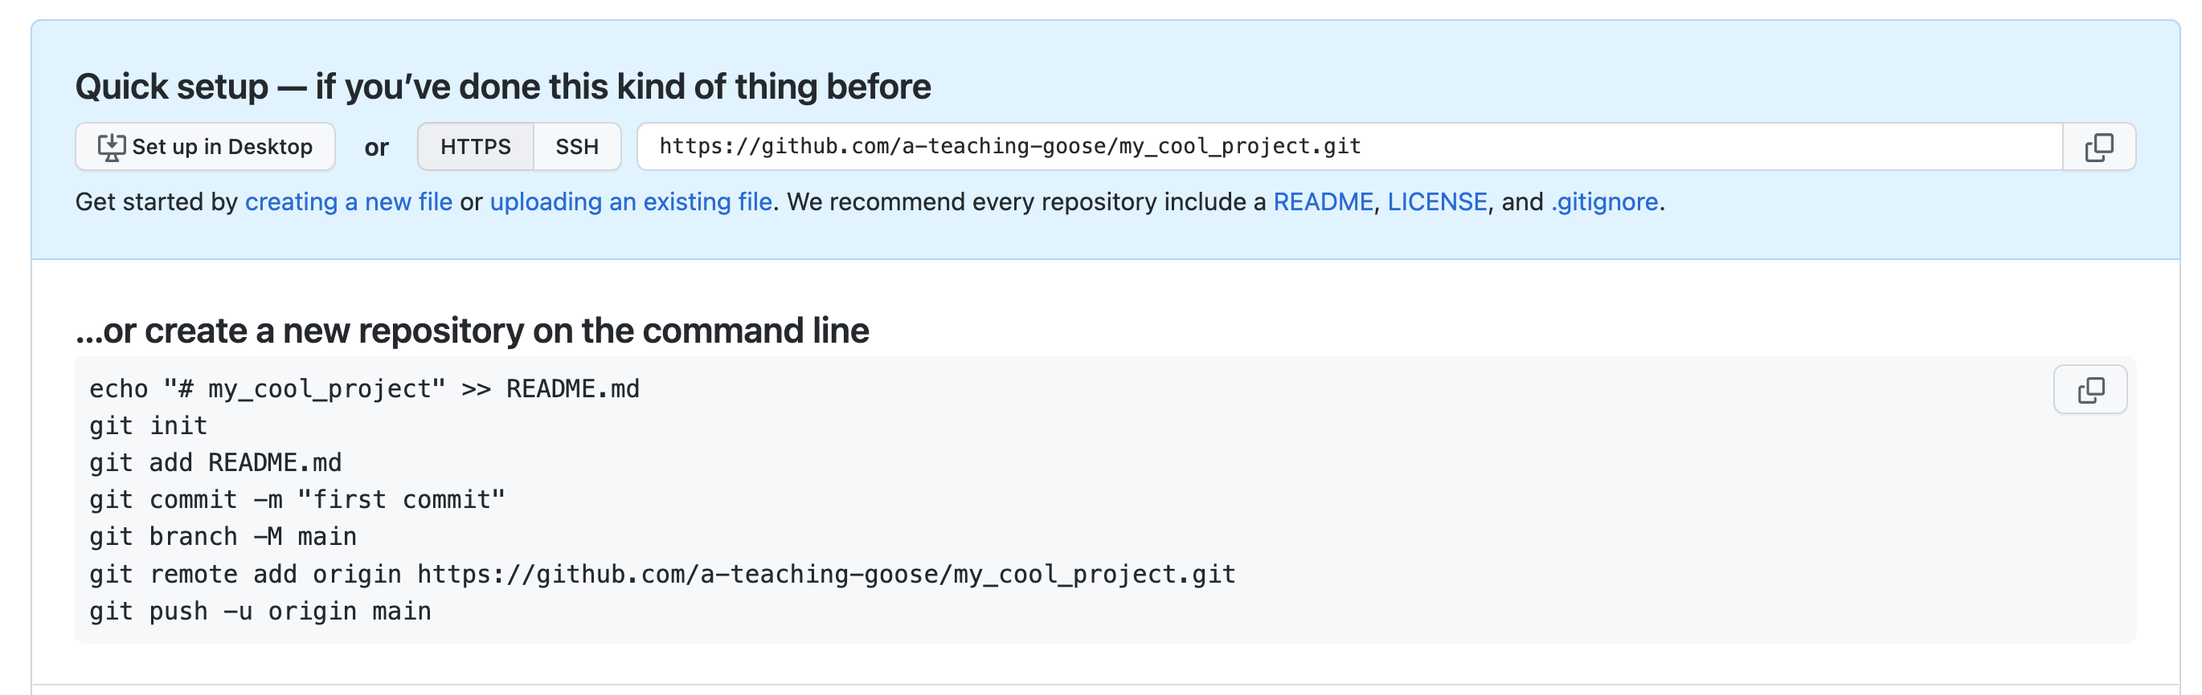

Slide 33
git remote add origin https://github.com/a-teaching-goose/my_cool_project.git
“Hey Git! Connect my local repo to a remote repo with the provided url, and I’ll use ‘origin’ on my laptop to refer to this remote repo”

Slide 34

git push
“Hey Git! Push my local repo to the remote repo”
git pull
“Hey Git! Get what’s in remote repo,
and merge with what I have in my local repo”

Slide 35

git push
“Hey Git! Push my local repo to the remote repo”

Slide 36
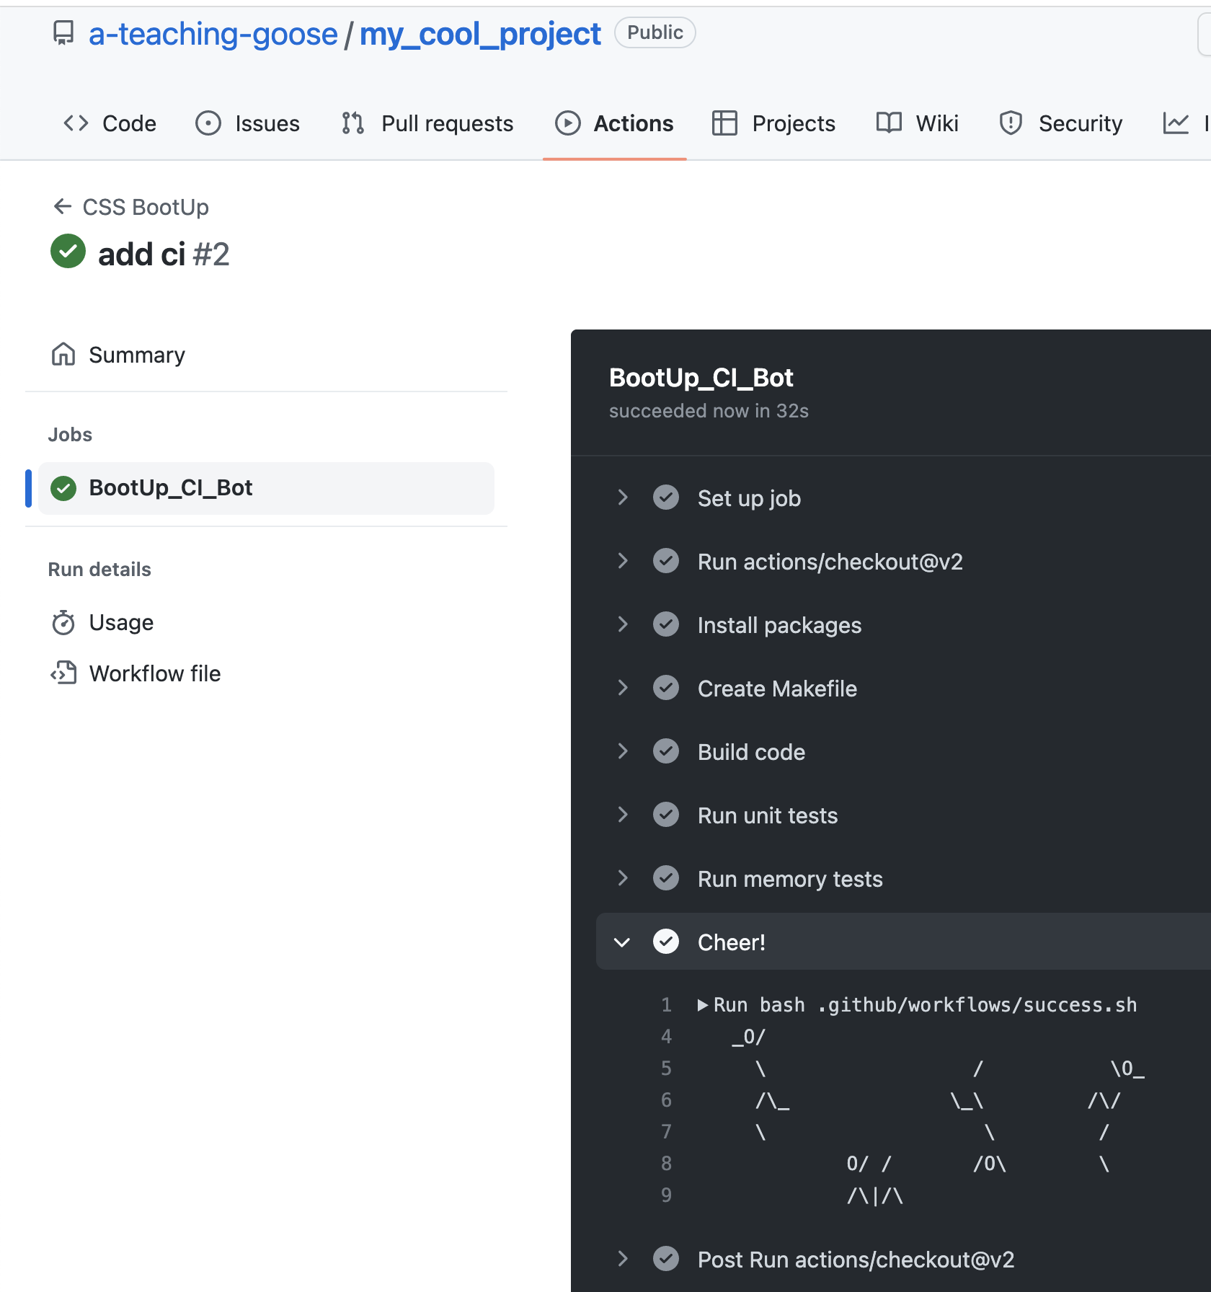
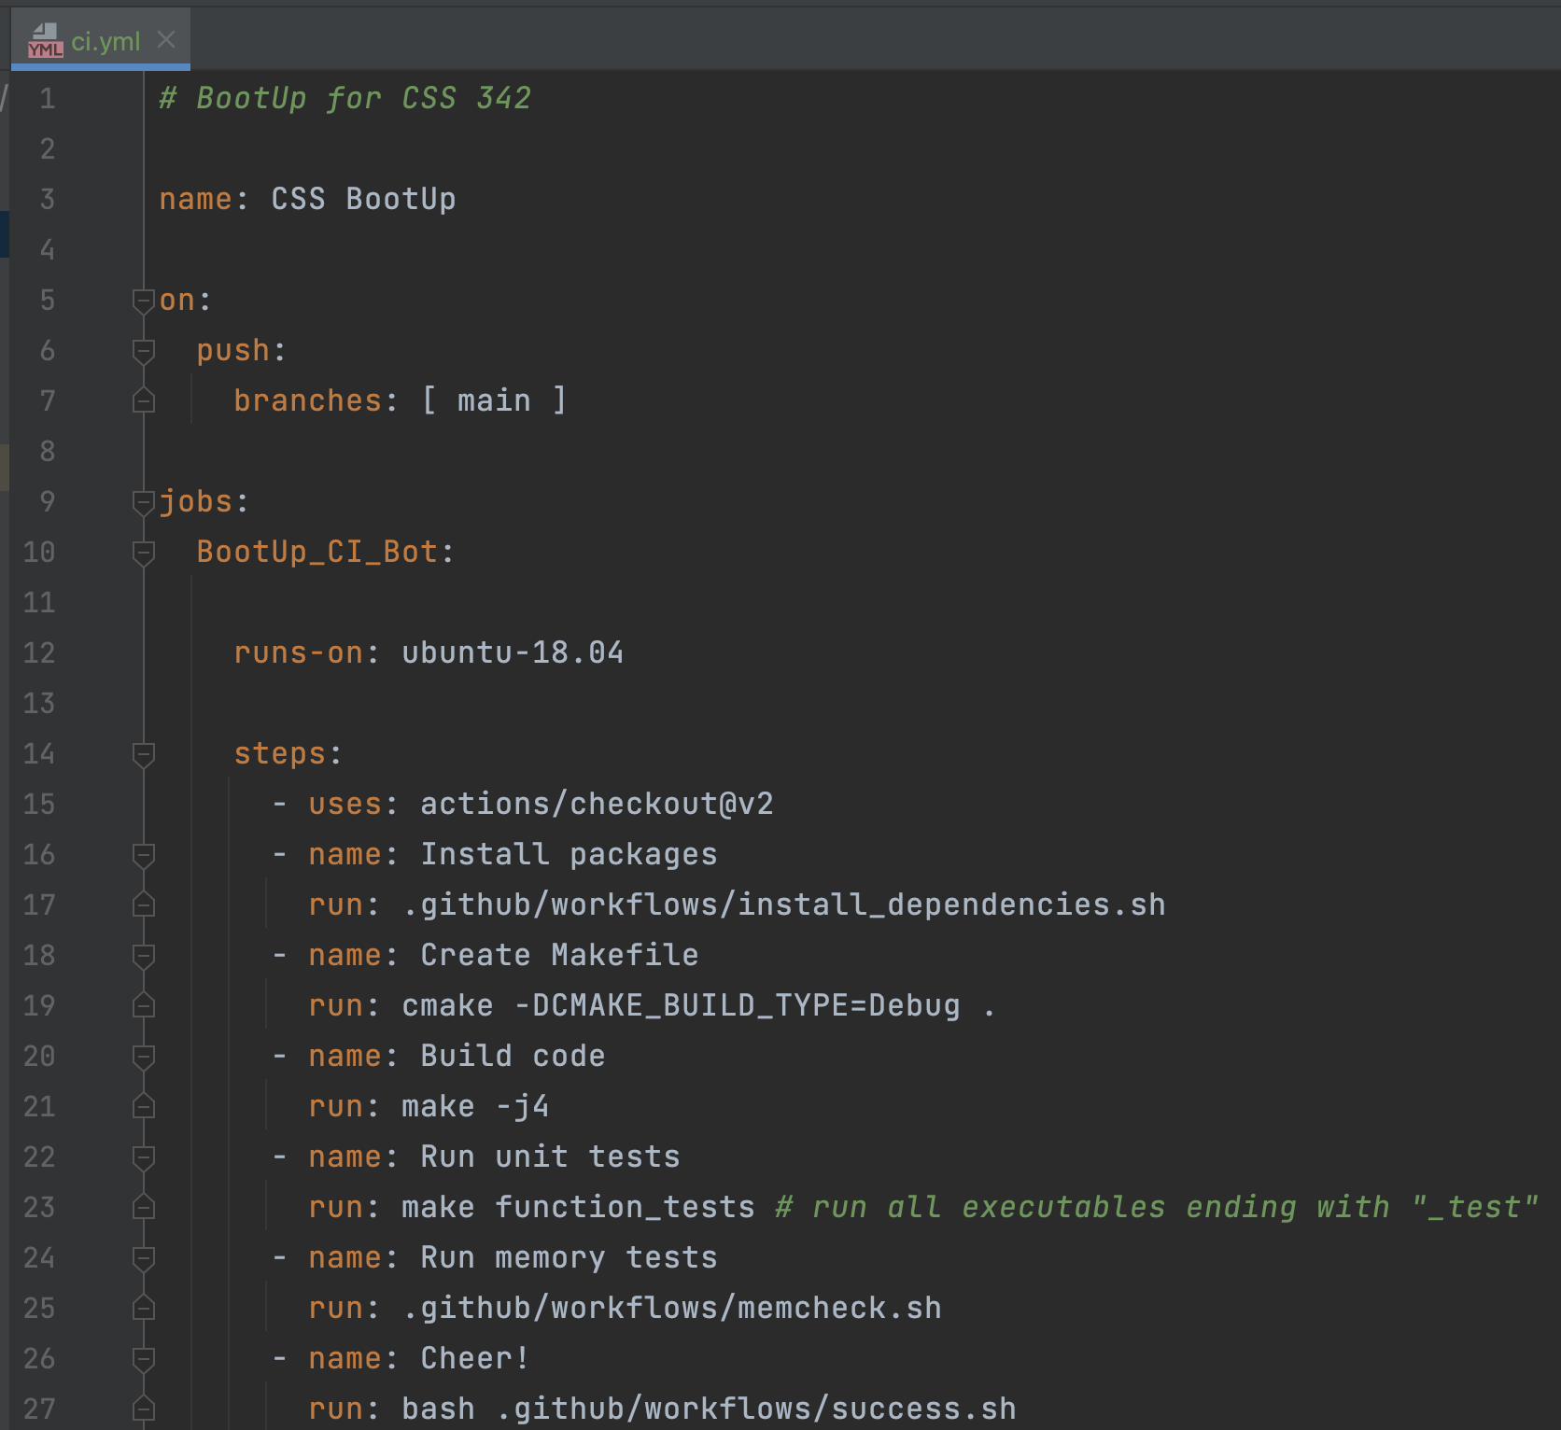
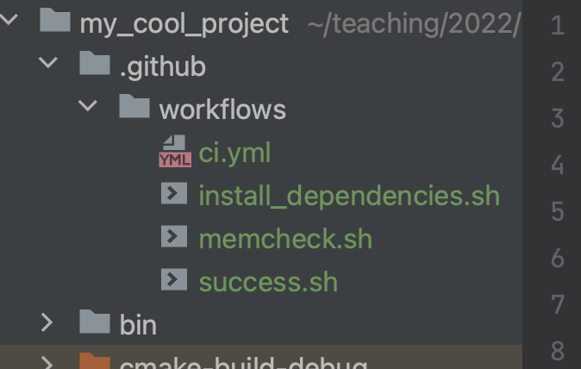
git push

Slide 37
Pull
Push

Slide 38
Remote repo
Exact Mirror
Local repo

Slide 39
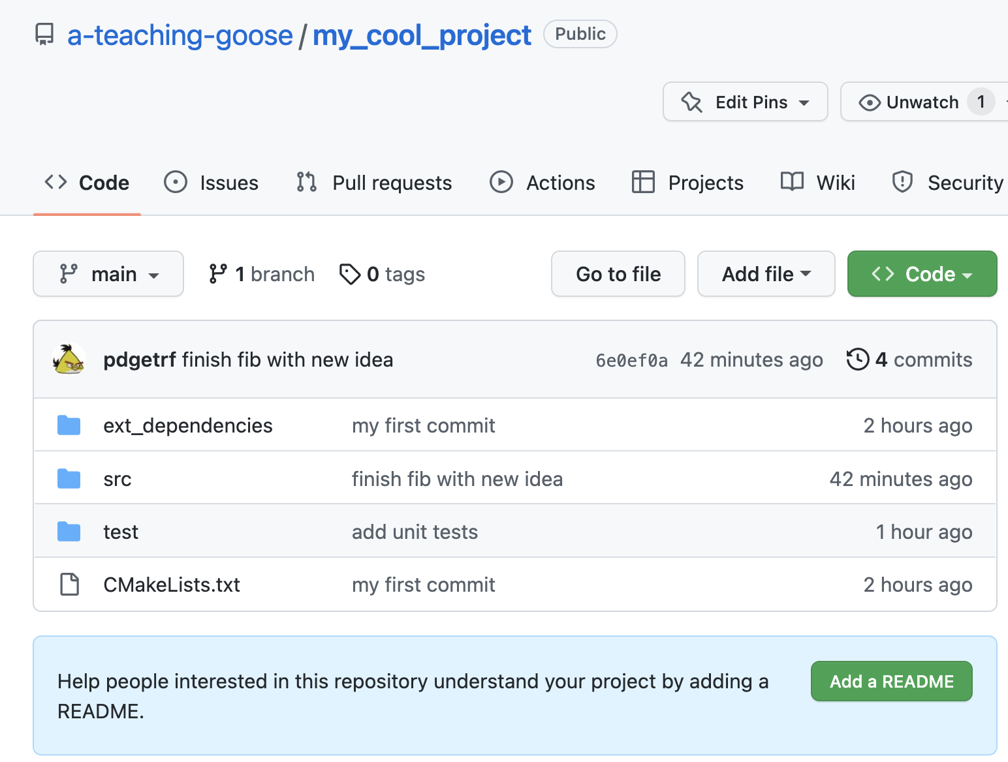
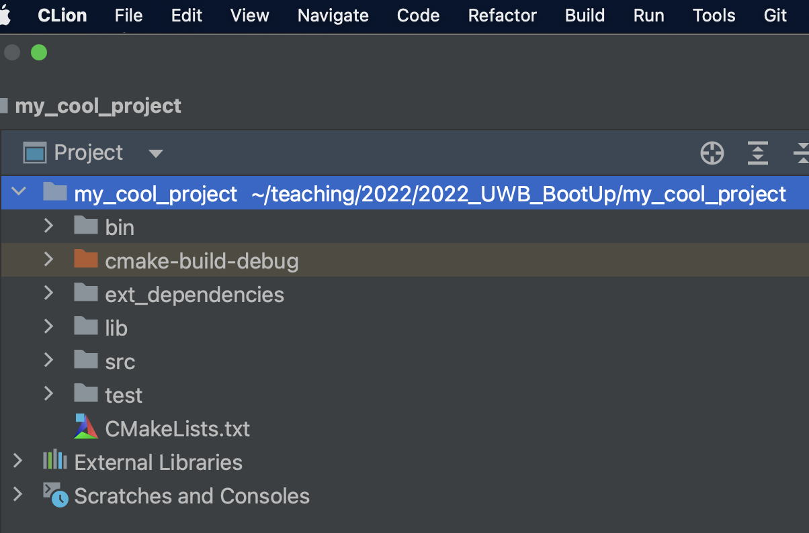

Slide 40


Slide 41
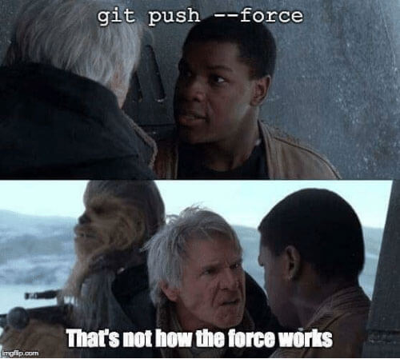
ACT II: Advanced Topics
Collaboration
Pull Request
Merge
Continuous Development
CI & CD

Slide 42

Create a pull request (for merge)
Run all unit tests
Code review by colleagues happens here
Need someone else would approve this

Slide 43
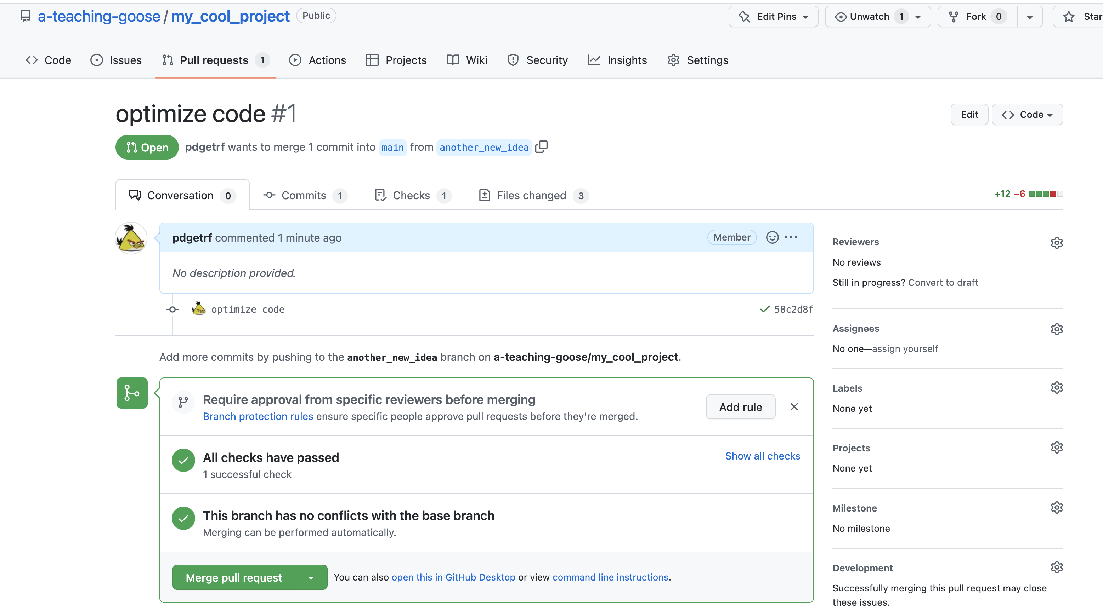
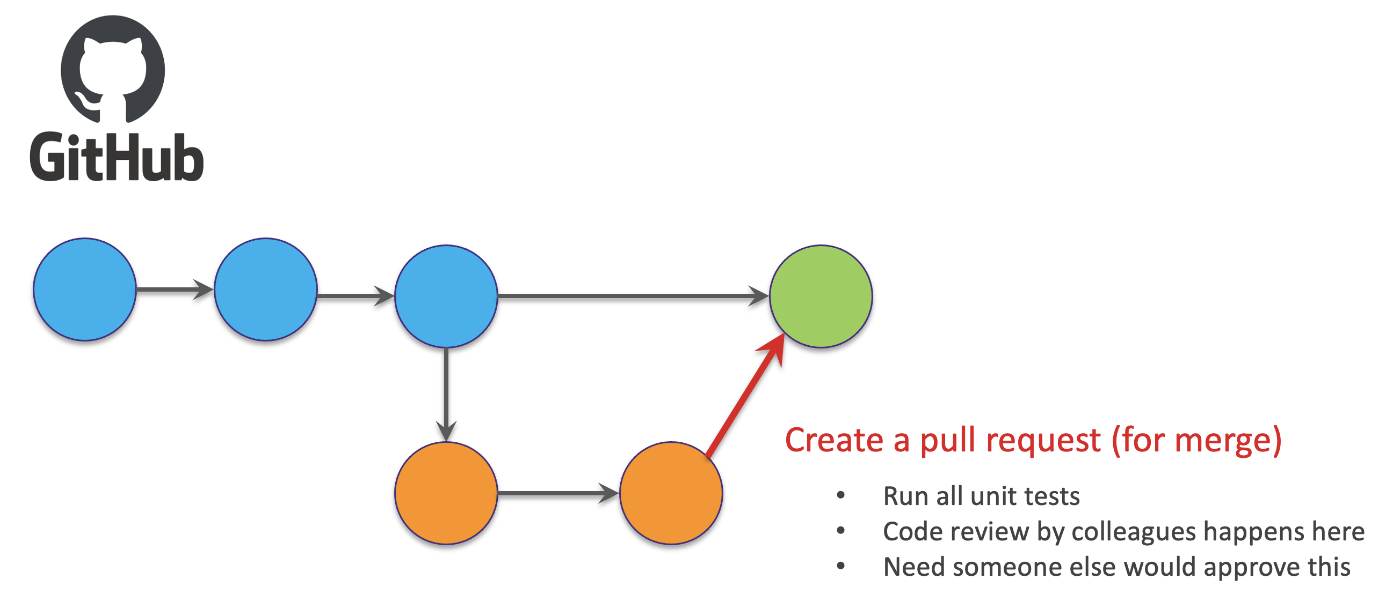
Find the finished code here

Slide 44

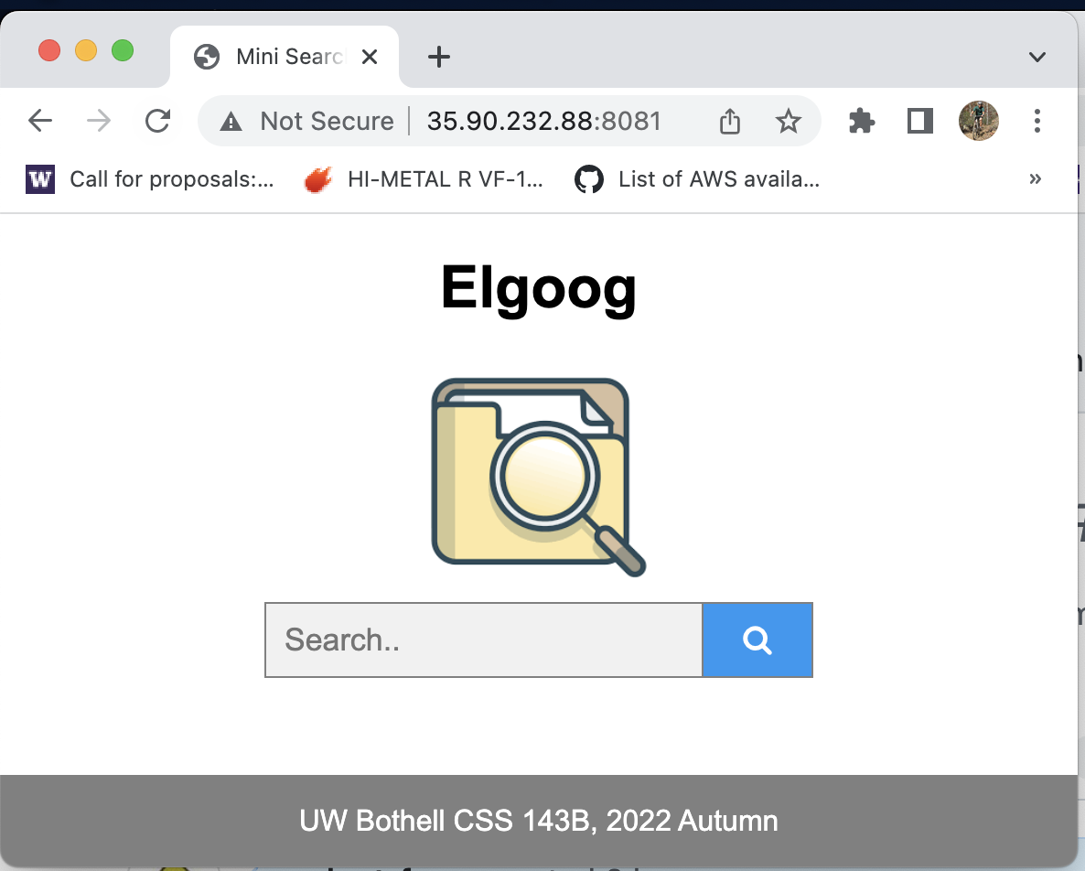

CI/CD
Clients/customers
”production site”
Tests (unit test, end-to-end test)
Your new code changes

Slide 45
Continuous Deployment Workflow (Generic)
Testing
(unit test, integration, e2e, etc.)
Staging
Production
Features &
Requirement
Coding
Git
(local)
GitHub
monitoring
Code Review
Deployment
Live Site
(updates, triage, etc.)

Slide 46
git push
git checkout -b new_idea
git pull
git merge new_idea
git init
git add .
git diff
git commit -am "commit message"
git log

Slide 47
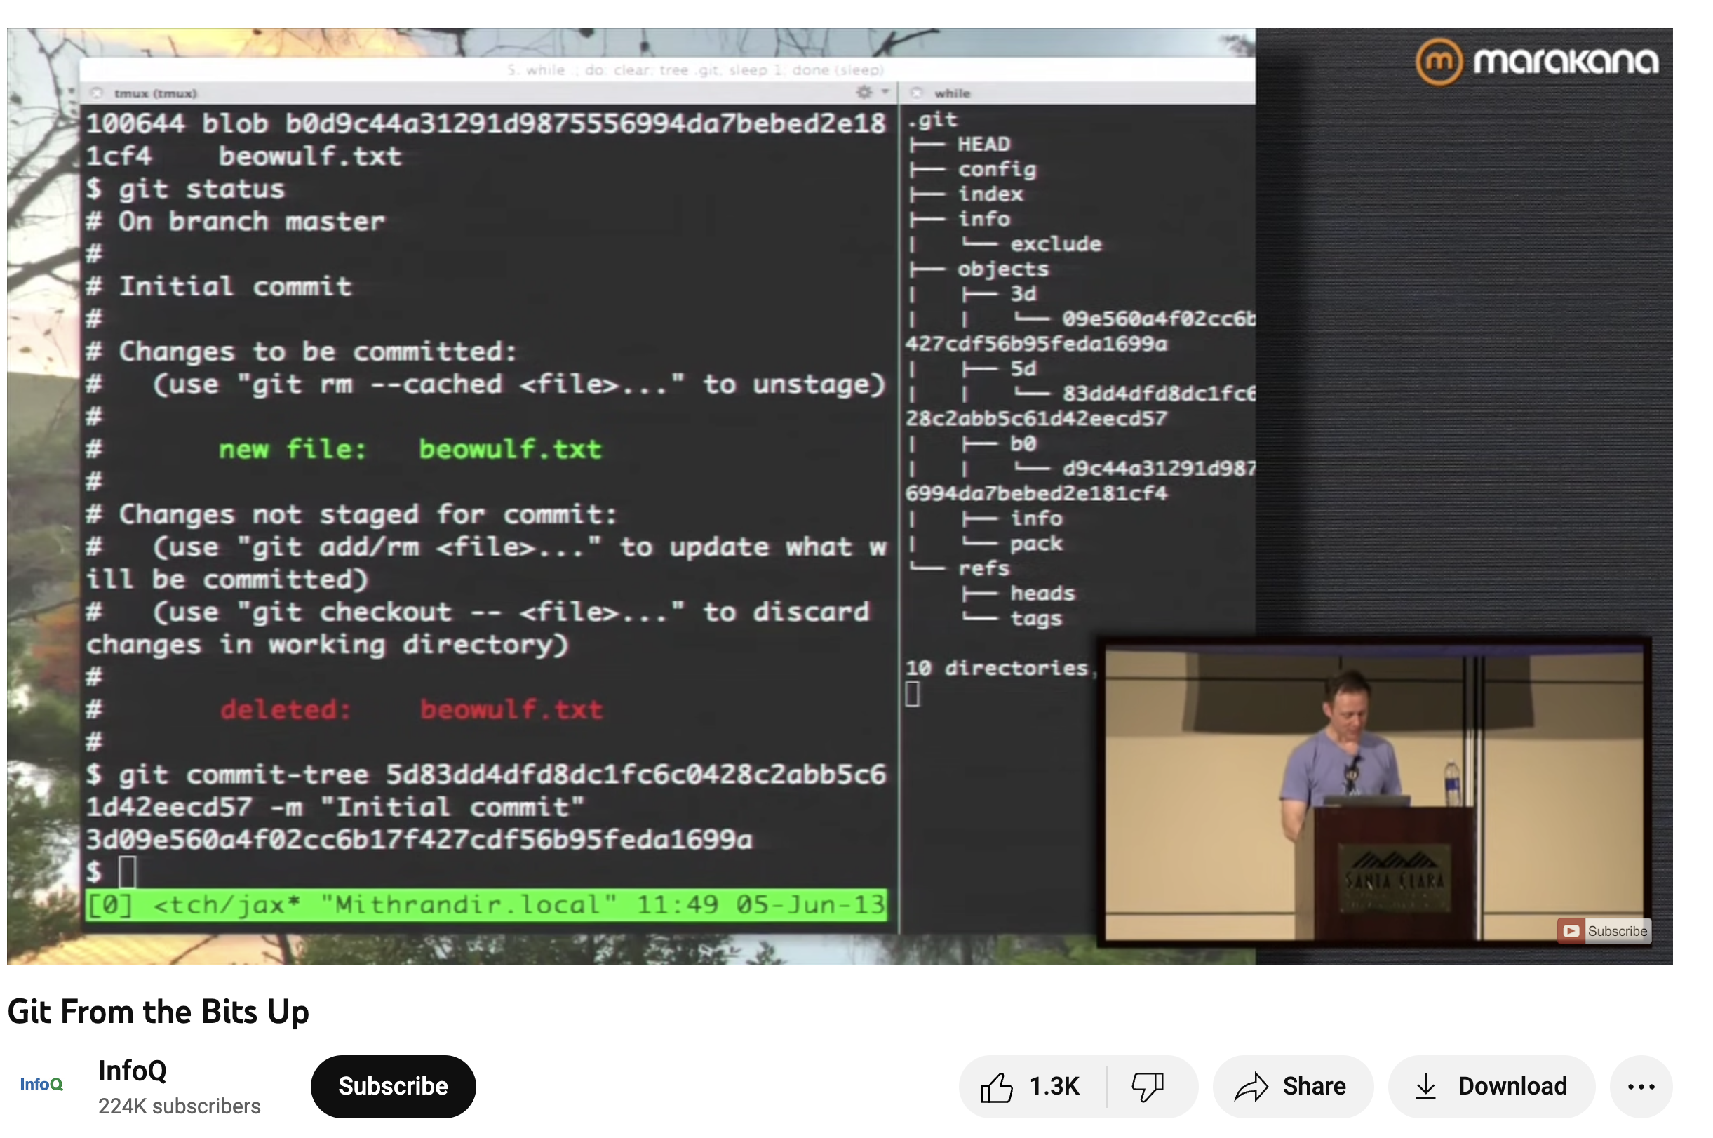
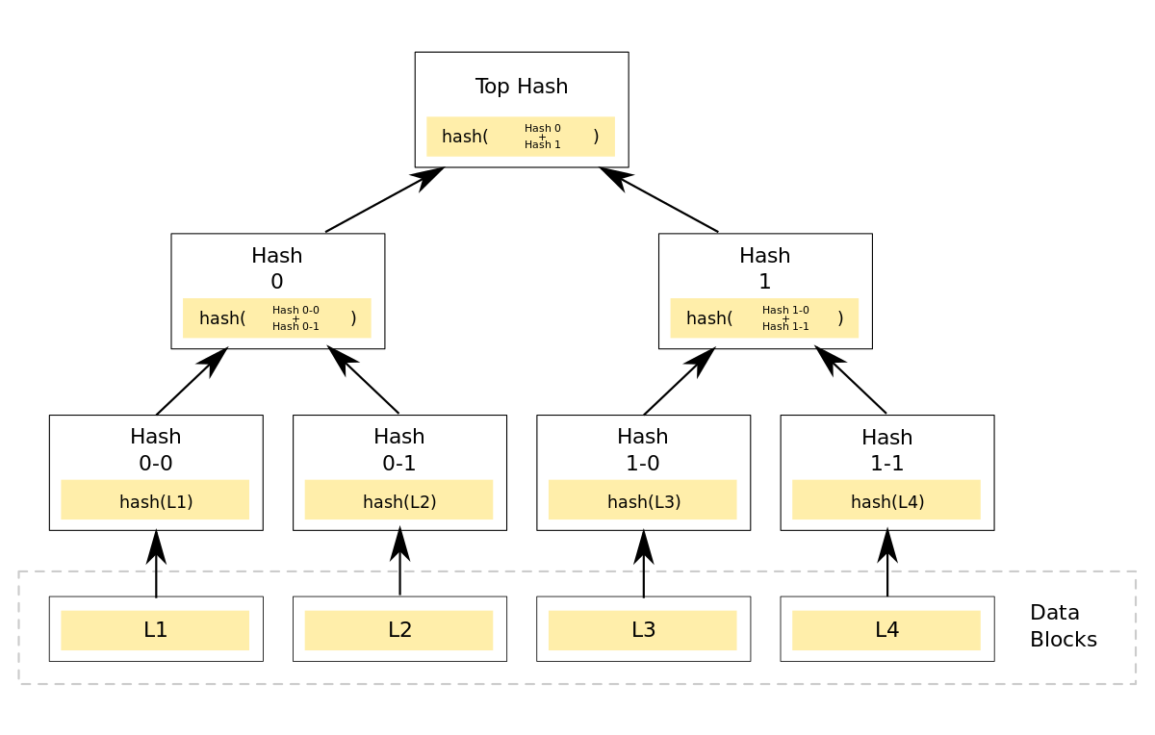
Git Internals
https://youtu.be/MYP56QJpDr4
https://en.wikipedia.org/wiki/Merkle_tree

Slide 48

#CodeSafely

Slide 49

Evaluation
https://forms.gle/7LuMUtW5S8gG4fkLA

